Slide 1

Client Server Architecture

Slide 2

Introduction
 A network architecture in which each computer or process on the network is either a client or a server.

Slide 3

Components
Clients
Servers
Communication Networks
Server
Client

Slide 4
Clients
Applications that run on computers
Rely on servers for
 Files
Devices
Processing power
 Example: E-mail client
Clients are Applications
 An application that enables you to send and receive e-mail

Slide 5
Servers
 Computers or processes that manage network resources
Disk drives (file servers)
Printers (print servers)
Servers Manage Resources
 Network traffic (network servers)
 Example: Database Server
 A computer system that processes database queries

Slide 6





Communication Networks
Networks Connect Clients and Servers

Slide 7
Client–Server Computing
 Process takes place
 on the server and
 on the client
 Servers
 Store and protect data
Client-Server Computing Optimizes Computing Resources
 Process requests from clients
Clients
Make requests
Format data on the desktop

Slide 8
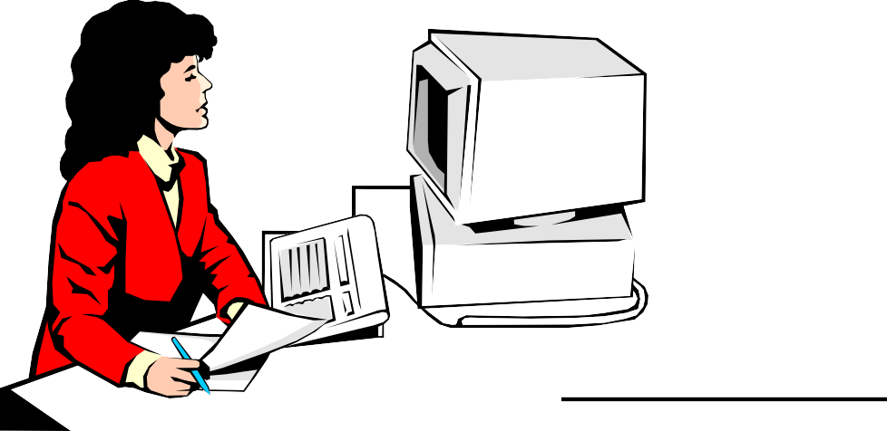
Application Functions
 Software application functions are separated into three distinct parts
Server: Data Management
Client: Presentation & Application Logic

Slide 9
Application Components
3
2
1
Data Management
Application Logic
Presentation
2 Client Types
Fat Client
Thin Client
3 Logical Tiers
Database Applications:
Most common use of client-server architectures

Slide 10
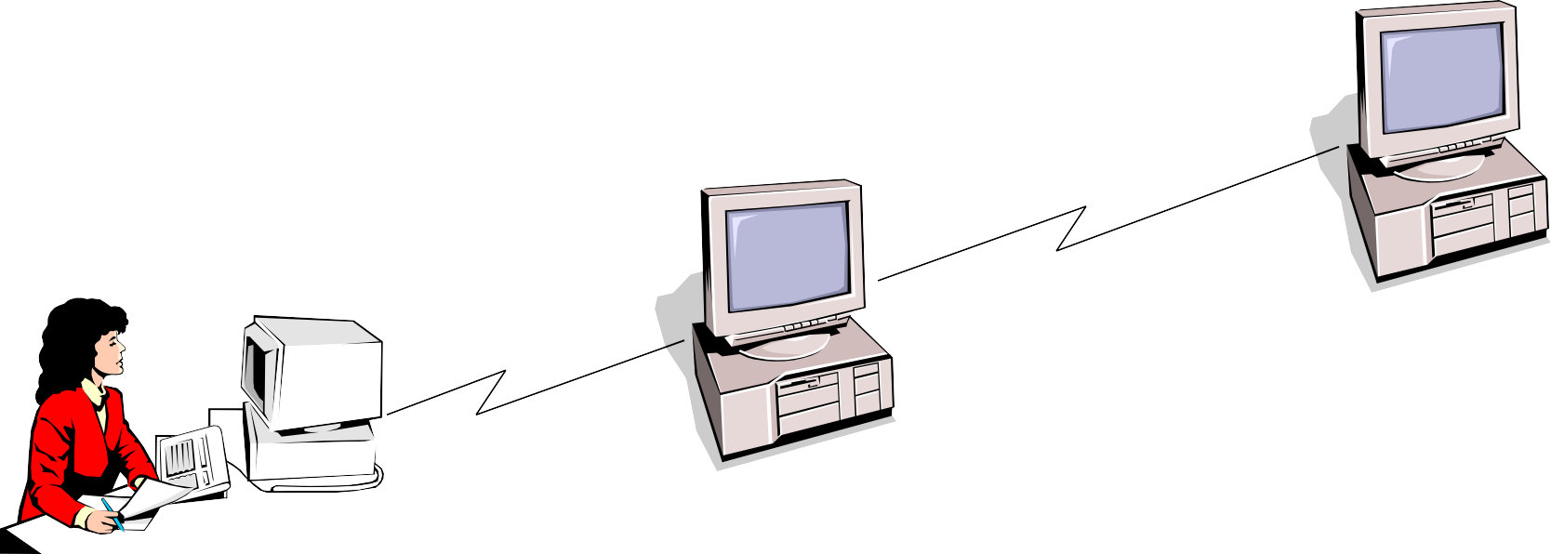
Middleware
Database Server:
Manages Data
Software that connects two
otherwise separate applications
Example: Middleware product linking a database system to a
Web server
Middleware Links Applications
Web Server:
Presents Dynamic Pages
Client: Requests Data via Web

Slide 11
Types of Servers
From A to Z
Application Servers
Audio/Video Servers
Chat Servers
Fax Servers
FTP Servers
Groupware Servers
IRC Servers
List Servers
Mail Servers
News Servers
Proxy Servers
Telnet Servers
Web Servers
Z39.50 Servers
Source: http://webopedia.lycos.com

Slide 12
Advantages
Improved Data Sharing
Integration of Services
Shared Resources amongst Different Platforms
Inter-Operation of Data
Data Processing capability despite the location
Easy maintenance
Security

Slide 13
Disadvantages


Overloaded servers
Impact of centralized architecture

